Slide 1


Computer Networks
X_400487
Lecture 10
Chapter 6: The Transport Layer—Part 2
Lecturer: Jesse Donkervliet

Slide 2
Roadmap: Transport Layer
Transport layer responsibilities and challenges
Connection establishment and release
Revisiting reliable delivery and flow control
  Reliable delivery
  Flow control
Congestion control and bandwidth allocation
TCP and UDP

Slide 3
The End-To-End Argument
The lower layers
If the network is unable to provide a feature by itself, it should be removed from the network and provided by the hosts.
Transport layer or higher
Q: Can you think of an example of a feature provided by the hosts?
Q: Can you think of a feature provided by the network?

Slide 4
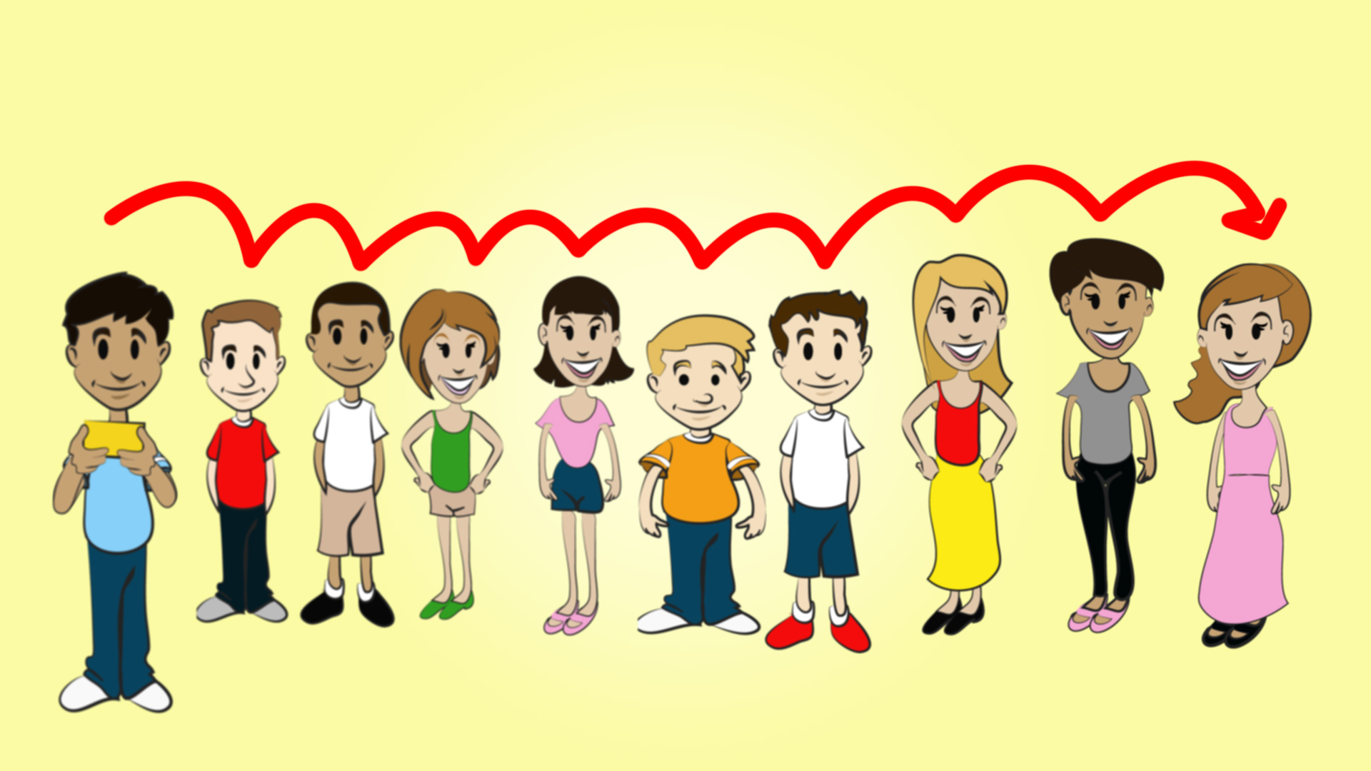
Error control in the transport layer
The transport layer is responsible for providing a reliable data stream over an unreliable network.
Q: Did we not take care of this in the data link layer?
Transport layer checks the
end-to-end correctness of data.
Q: Why not do error control only at the transport layer?

Slide 5



Reliable Delivery through
Retransmissions
M0
time
M0
M
A1
M0
A1

Slide 6
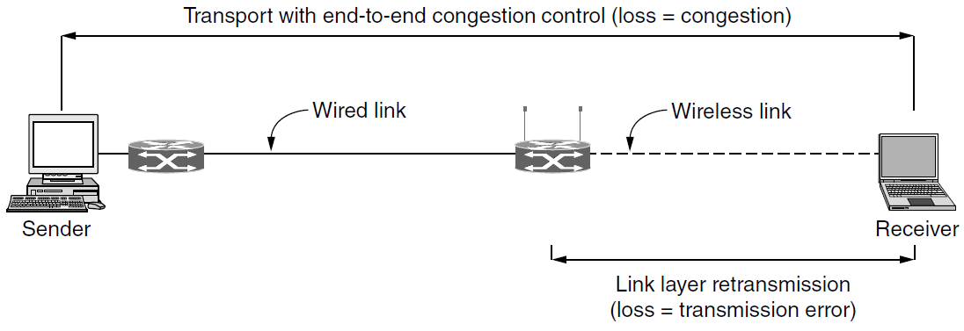
Improving Performance by using Error control on lower layers

Slide 7
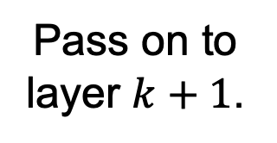
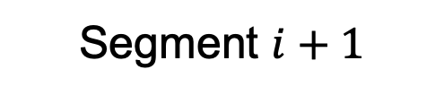

Error control and crash recovery
Protocol under normal circumstances.
2
Pass on to layer $k+1$.
Segment $i$
1
time
ACK
3
Segment $i+1$
4

Slide 8

Error control and crash recovery
Q: How to solve this?
Protocol when machines fail.
2
Pass on to layer $k+1$.
Segment $i$
1
time
ACK not transmitted!
Segment $i$
3

Slide 9
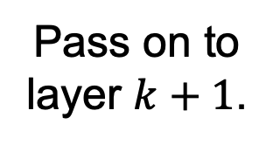
Crash recovery
Protocol under normal circumstances.
Segment $i$
3
1
time
Pass on to layer $k+1$.
ACK
2
Segment $i+1$
4

Slide 10
Error control and crash recovery
Protocol when machines fail.
Data not passed to next layer!
Segment $i$
1
time
ACK
2
Segment $i+1$
3

Slide 11

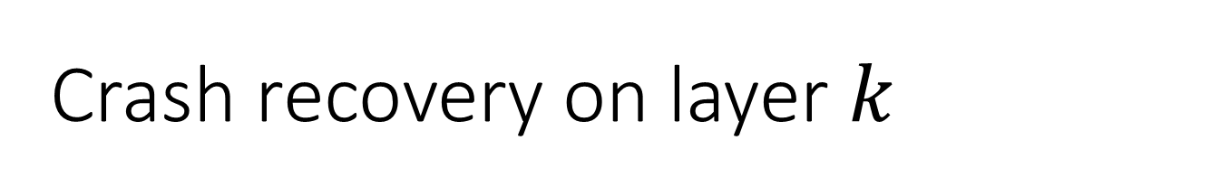
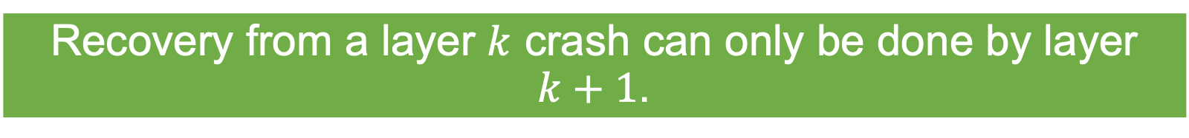

Crash recovery on layer $k$
We cannot create fool-proof crash recovery in layer $k$.
Recovery from a layer $k$ crash can only be done by layer $k+1$.
Q: What does this mean in practice?
When a crash occurs, the transport layer leaves it to the application layer to fix it!

Slide 12
Roadmap: Transport Layer
Transport layer responsibilities and challenges
Connection establishment and release
Revisiting reliable delivery and flow control
  Reliable delivery
  Flow control
Congestion control and bandwidth allocation
TCP and UDP

Slide 13


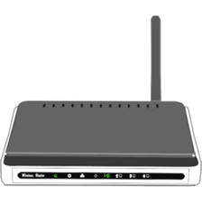
Regulating sending rate
Flow control
Phone cannot handle high data rate
M
M
B
M
Flow control is needed to slow down the sender if the receiver cannot handle the data rate
M
Small capacity receiver!
M
M
M
M
M
M
M
M
M
M
M
M
M
M
M
M
M
M
M
M
M
M
M
M
M
M
M
M
M
M
M
M
M
M
M
A
M
M
M
M
M
M

Slide 14
Regulating sending rate
Congestion control
B
Congestion control is needed to slow down the sender if the network cannot handle the data rate
M
M
Network cannot handle high data rate
M
M
M
M
M
M
M
M
M
M
Small capacity network!
M
M
M
M
M
M
M
M
M
M
M
M
M
M
M
M
A
M
M
M
M
M
M
M
M
This can also happen when many users share the same links

Slide 15
Stop-and-Wait:
A 1-Bit Sliding Window Protocol
1-bit sliding
window protocol
M
M
time
A
M
A
M
A
A

Slide 16
Stop-and-Wait:
A 1-Bit Sliding Window Protocol
1-bit sliding
window protocol
time
M
M
A
M
A
M
A
A
Bandwidth inefficient for high-latency channels

Slide 17
Sliding window protocols
Send multiple frames at the same time before waiting for an acknowledgement. (i.e., filling the pipe)

Slide 18

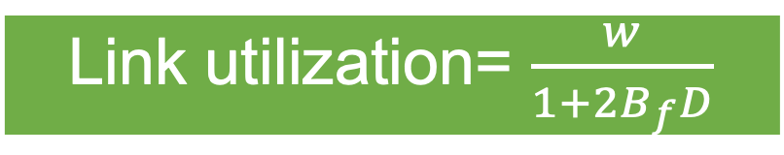
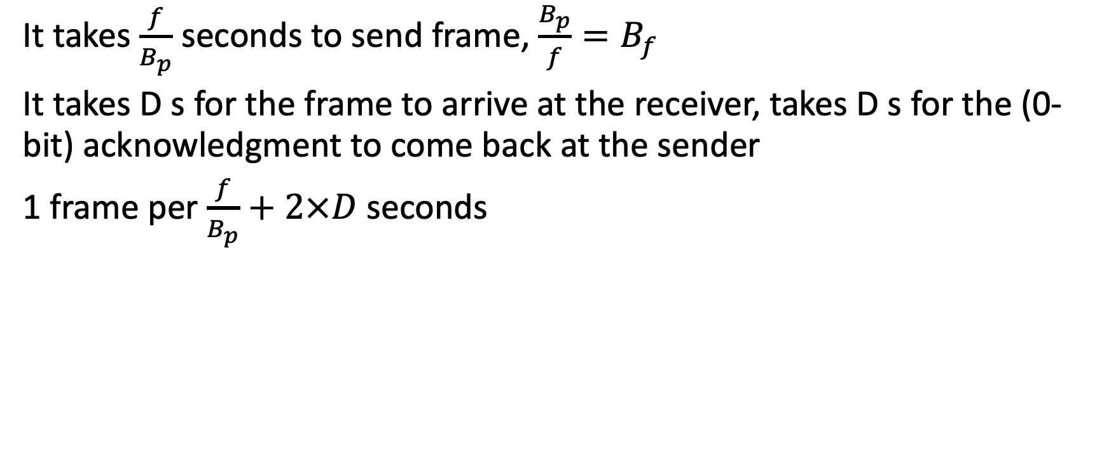
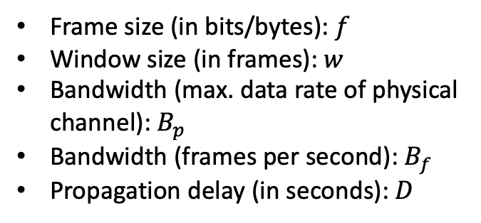


Recap: Link Utilization
Frame size (in bits/bytes): $f$
Window size (in frames): $w$
Bandwidth (max. data rate of physical channel): $B_{p}$
Bandwidth (frames per second): $B_{f}$
Propagation delay (in seconds): $D$
It takes $\frac{f}{B_{p}}$ seconds to send frame, $\frac{B_{p}}{f}=B_{f}$
It takes D s for the frame to arrive at the receiver, takes D s for the (0-bit) acknowledgment to come back at the sender
1 frame per $\frac{f}{B_{p}}+2×D$ seconds
Link utilization= $\frac{w}{1+2B_{f}D}$
B Mbps network
$$D$$
M
M
time
$$w=1$$
$$B$$
A
A
M

Slide 19

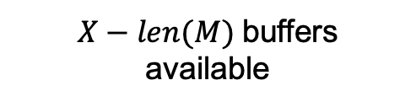
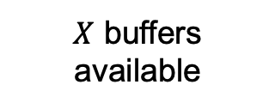
Flow control and buffer management
Used by TCP!
Received packets have to be buffered at the receiver.
Perform buffer management separately.
Use available buffer space as the receiver window size.
Q: Why do we need this?
We have to wait for the application to read the data
Piggybacked!
buffer
$X$ buffers available
M
M
Limit window size to $X$
$X−len(M)$buffers available

Slide 20
Roadmap: Transport Layer
Transport layer responsibilities and challenges
Connection establishment and release
Revisiting reliable delivery and flow control
Congestion control and bandwidth allocation
TCP and UDP

Slide 21
Today
Congestion Control in TCP/IP
DNS
Email
Quiz?!

Slide 22
Congestion control
Both packet loss and end-to-end delay can be used to signal congestion!
Both the network layer and the transport layer are responsible for congestion control.
The transport layer controls the workload; implements congestion control and flow control by reducing sending rate.
Ideal response
Network capacity
Desired response
Goodput
Delay
Congestion collapse
Congestion collapse
Network load
Network load

Slide 23
Congestion control requires resource management
Congestion occurs if the workload is too large for the available network resources.
The workload of all users combined should not be too large for the available network resources.
Coordinate to divide network resources

Slide 24

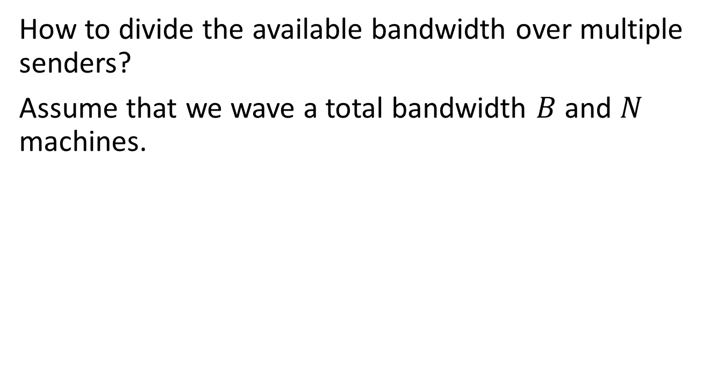


Fair bandwidth allocation
How to divide the available bandwidth over multiple senders?
Assume that we wave a total bandwidth $B$ and $N$ machines.
Q: How much bandwidth does each machine get?
May be impossible to implement with overlapping paths!
$$\frac{2}{3}$$
Bandwidth = 1
$$\frac{2}{3}$$
N = 3
B = 2
Bandwidth = 1
$$\frac{2}{3}$$
Does not fit on link!

Slide 25





Fair bandwidth allocation
Max-min fairness
Maximizes minimum bandwidth, then uses excess bandwidth where possible.
Q: Is this bandwidth allocation max-min fair?
No, because we can increase the minimum bandwidth.
Q: What is the downside of this method?
$$\frac{2}{3}$$
$$\frac{1}{2}$$
N = 3
$$\frac{1}{3}$$
$$\frac{1}{2}$$
B = 2
$$\frac{2}{3}$$
$$\frac{1}{2}$$

Slide 26
Fair bandwidth allocation
Convergence
When new connections enter the network, the bandwidth needs to be reallocated.
Max bandwidth
Ideal scenario. In practice, convergence takes more time.
Bandwidth
Q: Why is that?
Gray starts transmitting
Orange starts transmitting
time

Slide 27
Available bandwidth is unknown
Q: Why is this the case?
The transport layer is not aware of the network topology, or who else is using the network.
Because there is no centralized control, we need to dynamically adjust bandwidth usage using trial and error.
Q: How to solve this problem?
Network

Slide 28

Dynamically adjust bandwidth using trial and error
Keep trying to increase bandwidth usage.
Slow down when you receive congestion signal.
Max bandwidth
Can we send use this much bandwidth?
Alice’s bandwidth
Yes!
No!
time

Slide 29

Sharing bandwidth example
Alice
Bob

Slide 30
Sharing bandwidth example
Alice has 100% bandwidth Bob has 0% bandwidth
Both use 100% bandwidth
Network congestion (total 200%)
Both use 0% bandwidth
Network not used
Alice has 0% bandwidth
Bob has 100% bandwidth
Alice’s bandwidth
Bob’s bandwidth

Slide 31
Sharing bandwidth
Efficiency and fairness
100%
Optimum
Fairness line
(Alice and Bob have equal bandwidth)
Alice’s bandwidth
Efficiency line
(sum is 100%)
0%
100%
Bob’s bandwidth

Slide 32
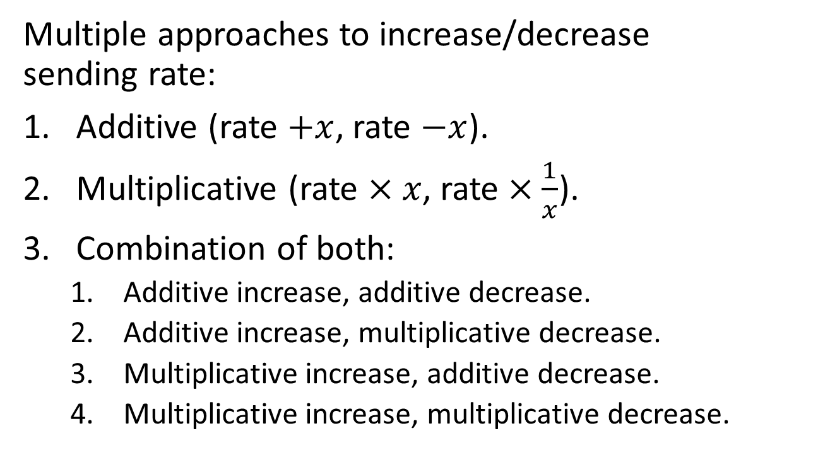
Regulating sending rate
Approaches
Q: Which one should we use?
Multiple approaches to increase/decrease
sending rate:
Additive (rate $+x$, rate $−x$).
Multiplicative (rate $×x$, rate $×\frac{1}{x}$).
Combination of both:
  Additive increase, additive decrease.
  Additive increase, multiplicative decrease.
  Multiplicative increase, additive decrease.
  Multiplicative increase, multiplicative decrease.

Slide 33


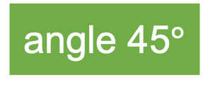
Additive increase
Additive decrease
angle 45$°$
100%
Q: What happens if we use this approach?
$$a$$
Below 100% bandwidth utilization No congestion
$$a$$
A: 80, B: 10 sum: 90
A: 90, B: 20 sum: 110
A: 80, B: 10 sum: 90
A: 90, B: 20 sum: 110
…
Efficiency line
(sum is 100%)
0%
100%

Slide 34




Multiplicative increase
Multiplicative decrease
Q: What happens if we use this approach?
100%
Vector from origin
A: 80, B: 10 sum: 90
A: 120, B: 15 sum: 135
A: 80, B: 10 sum: 90
A: 120, B: 15 sum: 135
…
$$r×m$$
Below 100% bandwidth utilization No congestion
$$r$$
$$r×m$$
$$r$$
Efficiency line
(sum is 100%)
0%
100%

Slide 35
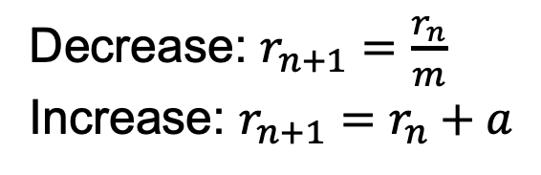
Regulating sending rate
Efficiency and fairness
Additive Increase Multiplicative Decrease (AIMD)
converges to optimum
100%
A: 80, B: 10 sum: 90
A: 90, B: 20 sum: 110
A: 45, B: 10 sum: 55
A: 55, B: 20 sum: 75
A: 65, B: 30 sum: 95
A: 75, B: 40 sum: 115
A: 37, B: 20 sum: 57
Multiplicative increase/decrease
Alice’s bandwidth
Additive increase/decrease
Efficiency line.
(sum is 100%)
Converges
0%
100%
Decrease: $r_{n+1}=\frac{r_{n}}{m}$
Increase: $r_{n+1}=r_{n}+a$
Bob’s bandwidth

Slide 36
Additive increase
Multiplicative decrease
100%
Additive increase
Multiplicative decrease
AIMD converges to / oscillates around optimum
0%
100%

Slide 37
Regulating sending rate
Efficiency and fairness
Q: What happens if bob uses another protocol such as UDP?
100%
Use TCP-friendly protocols to prevent unfair competition
Alice’s bandwidth
0%
100%
Decrease: $r_{n+1}=\frac{r_{n}}{m}$
Increase: $r_{n+1}=r_{n}+a$
Bob’s bandwidth

Slide 38
Roadmap: Transport Layer
Transport layer responsibilities and challenges
Connection establishment and release
Revisiting reliable delivery and flow control
Congestion control and bandwidth allocation
TCP and UDP

Slide 39
Internet protocols
The protocols that make the internet work.
Most popular on the transport layer:
UDP
TCP
But others exist!
All
or
Nothing
May not meet your application’s requirements!
Insufficient separation between mechanism and policy
You can create your own!

Slide 40
Comparing complexity by number of RFCs
Request For Comment (RFC) are published by the Internet Engineering Task Force (IETF).
UDP:
TCP:
RFC 768
Overview of RFCs in RFC 4614.
RFC 793
RFC 1122
RFC 1323
RFC 2018
RFC 2581
RFC 2873
RFC 2988
RFC 3168
RFC …
RFC …
…

Slide 41
User Datagram Protocol (UDP)
RFC 768
Very thin layer on top of IP. Header provides ports needed to connect to remote applications.
u
32 bits
Source port
Destination port
UDP length
UDP checksum
The UDP header

Slide 42
User Datagram Protocol (UDP)
RFC 768
Very thin layer on top of IP. Header provides ports needed to connect to remote applications.
UDP does not do:
Flow control
Congestion control
Retransmissions
32 bits
Source port
Destination port
UDP length
UDP checksum
The UDP header
Includes fields from the IP header!
Q: Can you name a service that works well with UDP?

Slide 43
Transmission Control Protocol (TCP)
One of the most important protocols on the internet.
Provides a reliable end-to-end byte stream over an unreliable network.
32 bits
Source port
Destination port
Sequence number
Acknowledgement number
header length
CWR
ECE
ACK
SYN
FIN
Window size
TCP checksum
Urgent pointer
Options (0 or more 32-bit words)
Data (optional)
The TCP header

Slide 44
Transmission Control Protocol (TCP)
Sequence numbers and acknowledgements allow
reliable, in-order delivery and enable sliding window protocols
32 bits
Source port
Destination port
Sequence number
Acknowledgement number
header length
CWR
ECE
ACK
SYN
FIN
Window size
TCP checksum
Urgent pointer
Options (0 or more 32-bit words)
Data (optional)
The TCP header

Slide 45
Transmission Control Protocol (TCP)
TCP checksum uses same IP-header fields
as the UDP checksum
32 bits
Source port
Destination port
Sequence number
Acknowledgement number
header length
CWR
ECE
ACK
SYN
FIN
Window size
TCP checksum
Urgent pointer
Options (0 or more 32-bit words)
Data (optional)
The TCP header

Slide 46
Transmission Control Protocol (TCP)
Q: How do we know how long the TCP segment is?
32 bits
Source port
Destination port
Sequence number
Acknowledgement number
header length
CWR
ECE
ACK
SYN
FIN
Window size
TCP checksum
Urgent pointer
Options (0 or more 32-bit words)
Data (optional)
The TCP header

Slide 47
Transmission Control Protocol (TCP)
Q: Used for flow control or congestion control?
32 bits
Source port
Destination port
Sequence number
Acknowledgement number
header length
CWR
ECE
ACK
SYN
FIN
Window size
TCP checksum
Urgent pointer
Options (0 or more 32-bit words)
Data (optional)
The TCP header

Slide 48
Connections in TCP

Slide 49
Transmission Control Protocol (TCP)
Used to establish/release connections
32 bits
Source port
Destination port
Sequence number
Acknowledgement number
header length
CWR
ECE
ACK
SYN
FIN
Window size
TCP checksum
Urgent pointer
Options (0 or more 32-bit words)
Data (optional)
The TCP header

Slide 50
TCP connection establishment
Three-way handshake
Uses timestamp option to improve performance on high-bandwidth networks
Every data byte has its own sequence number.*
*SYN and FIN also have their own sequence numbers.
Sequence number x+1:
bytes 0 to x have been received. Expecting byte x+1 next
Connection request SYN (seq=x)
Initial sequence numbers are randomly generated
SYN, ACK (seq=y, ack=x+1)
time
ACK (seq=x+1, ack=y+1)

Slide 51
TCP Timestamp Option
32 bits
Source port
Destination port
Sequence number
Acknowledgement number
header length
CWR
ECE
ACK
SYN
FIN
Window size
TCP checksum
Urgent pointer
Options (0 or more 32-bit words)
Data (optional)
The TCP header

Slide 52
TCP Timestamp Option
Q: How does this improve performance?
Use seq. number + timestamp to detect duplicates
32 bits
Source port
Destination port
Sequence number
Acknowledgement number
header length
CWR
ECE
ACK
SYN
FIN
Window size
TCP checksum
Urgent pointer
kind=8
length=10
timestamp value …
… timestamp value
timestamp echo reply …
… timestamp echo reply
Data (optional)
The TCP header

Slide 53
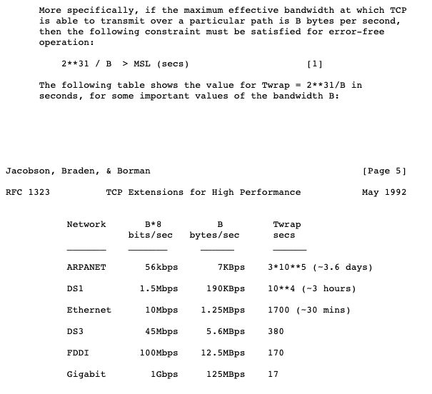
TCP PAWS

Slide 54
TCP sequence numbers
Initial sequence numbers are randomly generated
Every data byte has its own sequence number
A1
ACK (seq=x, ack=y)
ACK (seq=y, ack=x+len(a1))
time
B1
ACK (seq=x+len(a1), ack=y+len(b1))
A2

Slide 55
TCP connection release
Two simplex channels
Every data byte has its own sequence number.*
*SYN and FIN also have their own sequence numbers.
Connection release:
FIN, ACK (seq=x, ack=y)
ACK (seq=y, ack=x+1)
time
FIN, ACK (seq=y+1, ack=x+1)
ACK (seq=x+1, ack=y+2)

Slide 56
TCP connection release
Two simplex channels
Q: How to solve the two army problem?
Every data byte has its own sequence number.*
*SYN and FIN also have their own sequence numbers.
Connection release:
FIN, ACK (seq=x, ack=y)
FIN, ACK (seq=y, ack=x+1)
time
ACK (seq=x+1, ack=y+1)

Slide 57
Error Control in TCP

Slide 58
Reliable Delivery through
Retransmissions
M0
time
M0
M
A1
M0
A1

Slide 59
Setting Retransmission Timers
How long should we wait before retransmitting a frame?
Timer must be longer than round-trip time.
If we set timer too high, bandwidth efficiency goes down
Q: What are the bounds?
Congestion makes round-trip time variable!

Slide 60
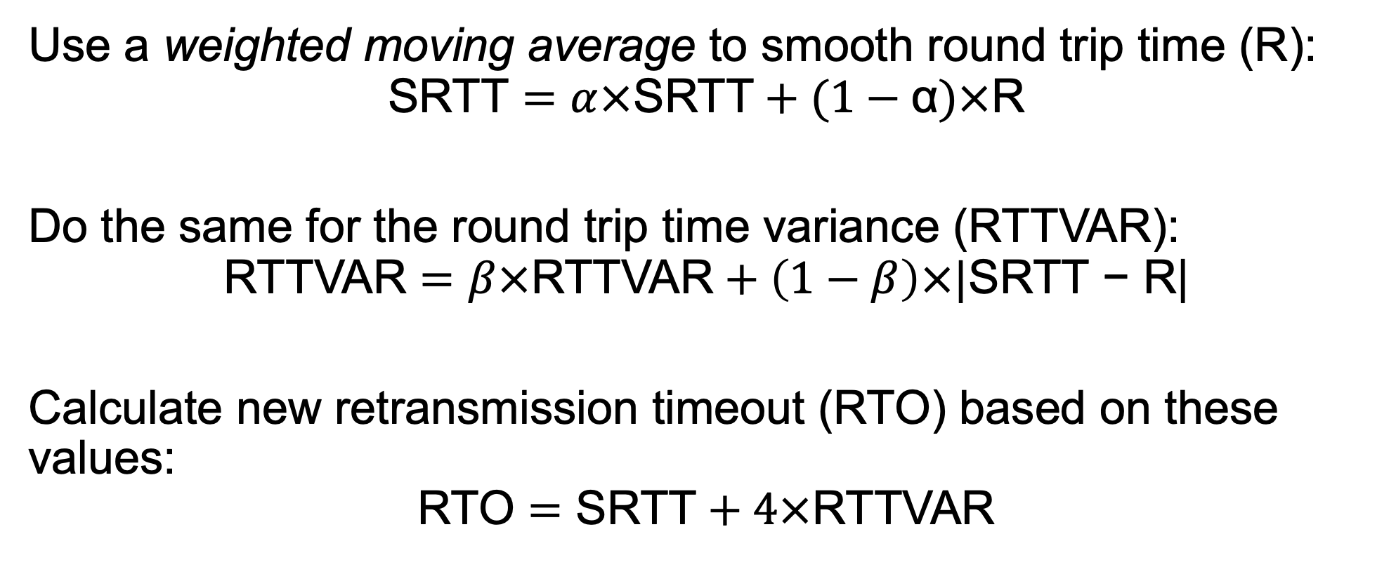
Dynamic Timeouts in TCP
Use a weighted moving average to smooth round trip time (R):
$$\text{SRTT}=α×\text{SRTT}+(1−\text{α})×\text{R}$$
Do the same for the round trip time variance (RTTVAR):
$$\text{RTTVAR}=β×\text{RTTVAR}+\left(1−β\right)×|\text{SRTT}\text{ − }\text{R}\text{|}$$
Calculate new retransmission timeout (RTO) based on these values:
$$\text{RTO}=\text{SRTT}+4×\text{RTTVAR}$$

Slide 61
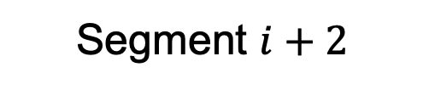

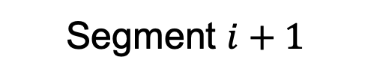


Performance improvement
Fast retransmission
Takes time
(by design)!
Packet loss detected when timers expire.
Q: Can we know about packet loss before the timer runs out?
Segment $i$
time
ACK $i$
Segment $i+1$
Segment $i+2$
ACK $i$
Q: Assumption?
Duplicate acknowledgments can indicate packet loss

Slide 62
Flow Control in TCP

Slide 63
Flow control and buffer management
Used by TCP!
Received packets have to be buffered at the receiver.
Perform buffer management separately.
Use available buffer space as the receiver window size.
Q: Why do we need this?
We have to wait for the application to read the data
Piggybacked!
buffer
$X$ buffers available
M
M
$X−len(M)$buffers available

Slide 64
TCP window size
Flow control
Q: Can you think of a potential problem?
The window size tells sender how much data the receiver can handle.
2K data, seq 1
Ack 2K+1, win 2K
time
2K data, seq 2K+1
Ack 4K+1, win 0
Ack 4K+1, win 2K

Slide 65
TCP window size
Nagle’s algorithm
Do not send more than one small packet at a time: wait for ack
Q: For which applications may this not work well?
A sender that produces data in small amounts.
Small segments cause large overhead
Q: Can you think of an application that does this?
1 byte data, seq 1
Ack 2, win 2047
time
1 byte data, seq 2
Ack 3, win 2046

Slide 66
TCP window size
Silly-window syndrome
Do not send window updates if available space is too small
A receiver that consumes data in small amounts.
Tiny window sizes cause large overhead
Ack 1, win 1
1 byte data, seq 1
time
Ack 2, win 0
Ack 2, win 1
1 byte data, seq 2

Slide 67
TCP Delayed Acknowledgements
Try to improve bandwidth efficiency (e.g., through piggy-backing)
Wait up to 500 ms to send acknowledgement
Send acknowledgement for every second full-size segment
100 bytes data, seq 1
time
500 bytes data, seq 1,
ack 101
500 ms timer

Slide 68
TCP Delayed Acknowledgements
Try to improve bandwidth efficiency (e.g., through piggy-backing)
Wait up to 500 ms to send acknowledgement
Send acknowledgement for every second full-size segment
536 bytes data, seq 1
536 bytes data, seq 537
time
500 ms timer
ack 1073

Slide 69
Congestion Control in TCP

Slide 70
Transmission Control Protocol (TCP)
Used for Explicit Congestion Notification
32 bits
Source port
Destination port
Sequence number
Acknowledgement number
header length
CWR
ECE
ACK
SYN
FIN
Window size
TCP checksum
Urgent pointer
Options (0 or more 32-bit words)
Data (optional)
The TCP header

Slide 71
Additive increase multiplicative decrease in TCP
AIMD used to prevent network congestion. Converges to fair and efficient bandwidth allocation.
TCP implements this using its congestion window.
Not the same as the ‘window size’ field in the TCP segment header!
Congestion window is tracked on the sender.
Specifies how many segments can be transmitted.
Q: How does TCP combine the two windows?

Slide 72
AIMD in TCP
What value to start with?
We want fast convergence, but sending a large burst can occupy low-bandwidth links for a long time.
Increase congestion window whenever acknowledgements arrive.
M
M
M
M
M
M
A
A
A
A
A
A
Alice
Low bandwidth
Acknowledgement rate tells us data rate of slowest link.

Slide 73
AIMD in TCP
‘slow’ start
Previous algorithm used congestion window = flow control window.
Slow start is slower in comparison
Congestion window size grows based on acknowledgment rate
data
ack
time
Q: What kind of growth does this cause?

Slide 74
TCP ‘slow’ start
Arbitrary threshold switches from ‘slow’ start to additive increase.
Congestion window growing over time
Current window
Threshold
Slow start
Congestion window
(KB or packets)
Transmission round (RTTs)

Slide 75
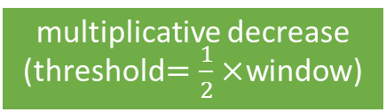
TCP Tahoe
Q: Can you think of another way to detect packet loss?
Arbitrary threshold switches from ‘slow’ start to additive increase.
Additive increase
Packet loss detected
Reset congestion window
Current window
Threshold
Congestion window
(KB or packets)
Threshold
multiplicative decrease
(threshold$=\frac{1}{2}×$window)
Wait 1 RTT for segments to leave the network
Transmission round (RTTs)

Slide 76

Performance improvement
Fast retransmission
Takes time
(by design)!
Packet loss detected when timers expire.
Q: Can we know about packet loss before the timer runs out?
#packets in transit
Segment $i$
1
ACK $i$
time
0
Segment $i+1$
1
2
Segment $i+2$
ACK $i$
1
We can count the number of packets in the network!

Slide 77
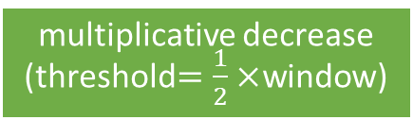
TCP Reno
(= TCP Tahoe + fast recovery)
Calculates the number of segments in the network by
counting the number of duplicate acknowledgements
Threshold reduced using multiplicative decrease.
Congestion window set to new threshold value.
Packet loss detected
Current window
Threshold
multiplicative decrease
(threshold$=\frac{1}{2}×$window)
Congestion window
(KB or packets)
Threshold
Fast recovery
Transmission round (RTTs)

Slide 78
What about
Explicit Congestion Notification?
M
= regular IP packet with TCP segment
M
= Explicit Congestion Notification (ECN) set in IP header
Congested Router
M
M
M
M

Slide 79
What about
Explicit Congestion Notification?
M
= regular IP packet with TCP segment
M
= Explicit Congestion Notification (ECN) set in IP header
M
= ECN-Echo (ECE) set in TCP header
M
M
M
M

Slide 80
What about
Explicit Congestion Notification?
M
= regular IP packet with TCP segment
M
= Explicit Congestion Notification (ECN) set in IP header
M
= ECN-Echo (ECE) set in TCP header
M
= Congestion Window Reduced (CWR) set in TCP header
M
M
M
M

Slide 81
Different Flavors of TCP

Slide 82
TCP versions and congestion signals
TCP determines rate based on
packet loss.
CUBIC TCP determines rate based on
packet loss.
FAST TCP determines rate based
on end-to-end delay.
Compound TCP determines rate based
on end-to-end delay and packet loss.
TCP with Explicit Congestion Notification.
XCP explicitly tells sender what rate to use.
Used by default in Linux, Windows, MacOS

Slide 83
TCP versions and congestion signals
Implicit congestion signals
TCP determines rate based on
packet loss.
CUBIC TCP determines rate based on
packet loss.
FAST TCP determines rate based
on end-to-end delay.
Compound TCP determines rate based
on end-to-end delay and packet loss.
TCP with Explicit Congestion Notification.
XCP explicitly tells sender what rate to use.
Used by default in Linux, Windows, MacOS

Slide 84
Roadmap: Transport Layer
Transport layer responsibilities and challenges
Connection establishment and release
Revisiting reliable delivery and flow control
Congestion control and bandwidth allocation
TCP and UDP

Slide 85
Transport Layer Summary
Sockets interface
Connection establishment and release
  Duplicate detection
  Two army problem
Seq. num wrap around + duplicate detection → performance limit
End-to-end argument
Error control
  Timer management
  Detection using time-outs or duplicate acknowledgements
Flow control
  Sending rate limited to smallest
  window size
  Nagle’s algorithm
  Silly window syndrome
Congestion control
  Sharing available resources
    AIMD
  Multiple signals: packet loss, latency, etc.

